Slide 1
CSE231 – Digital Logic Design
NAND-NAND and NOR-NOR Circuits
and
Even and Odd Logic Functions

Slide 2
Logic Gates
AND and OR Gates
  2-input gates realized with 6 CMOS transistors
  3-input gates realized with 8 CMOS transistors
NAND and NOR Gates
  2-input gates realized with 4 CMOS transistors
  3-input gates realized with 6 CMOS transistors
Therefore, it is more cost efficient to design logic circuits from NAND and NOR gates.

Slide 3
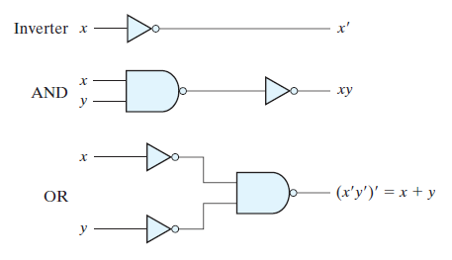
Using the NAND Gate

Slide 4


“Redrawing” the NAND Gate
bubble denotes inversion
Remember, this is an application of DeMorgan's Theorem

Slide 5
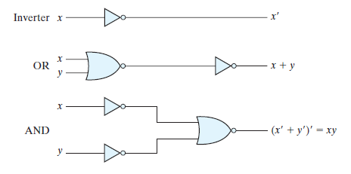
Using the NOR Gate

Slide 6


“Redrawing” the NOR Gate
bubble denotes inversion
Remember, this is an application of DeMorgan's Theorem

Slide 7
SOP using NAND Gates
Converting from AND-OR to NAND-NAND
  Draw the AND-OR logic circuit for the SOP expression.
  Add bubbles (inversion)
    At the output of each AND gate
    At the corresponding inputs of the OR gate
    Two bubbles on the same signal cancel (A'' = A)
  All gates in the logic circuit are NAND gates
    Two different representations for the NAND gate
    74xx08 Quad 2-input NAND Gate

Slide 8
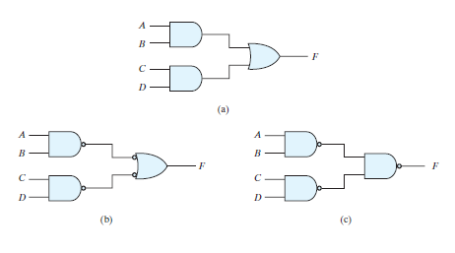
NAND Gate Realization of SOP

Slide 9
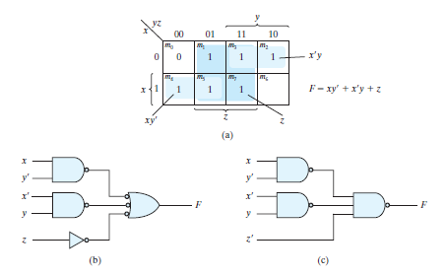
NAND Gate Realization of SOP

Slide 10
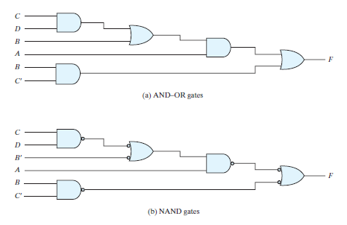
NAND Gate Realization of a multilevel AND-OR Circuit

Slide 11
POS using NOR Gates
Converting from OR-AND to NOR-NOR
  Draw the OR-AND logic circuit for the POS expression.
  Add bubbles (inversion)
    At the output of each OR gate
    At the corresponding inputs of the AND gate
    Two bubbles on the same signal cancel (A'' = A)
  All gates in the logic circuit are NOR gates
    Two different representations for the NOR gate
    74xx02 Quad 2-input NOR Gate

Slide 12
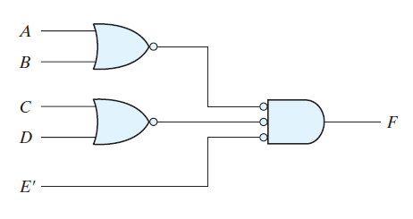
NOR Gate Realization of POS
Need to include (or draw on the board) the OR-AND circuit.

Slide 13
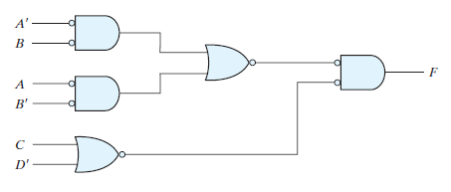
NOR Gate Realization of POS
Need to include (or draw on the board) the OR-AND circuit.

Slide 14
Example:
Implement the function
F(A,B,C) = Σ m(0,2,3,7)
using only NAND gates.

Slide 15
Example:
Implement the function
F(A,B,C) = Σ m(0,2,3,7)
using only NOR gates.

Slide 16
Example:
Implement the function
F(A,B,C) = Π M(1,5,6,7)
using only NOR gates.

Slide 17
Example:
Implement the function
F(A,B,C) = Π M(1,5,6,7)
using only NAND gates.

Slide 18
Even and Odd Logic Functions

Slide 19
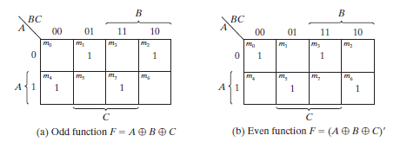
Even and Odd Logic Functions
Why is this an odd function?
Why is this an even function?

Slide 20
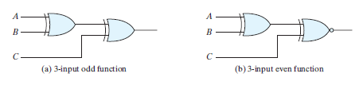
Even and Odd Logic Circuits

Slide 21
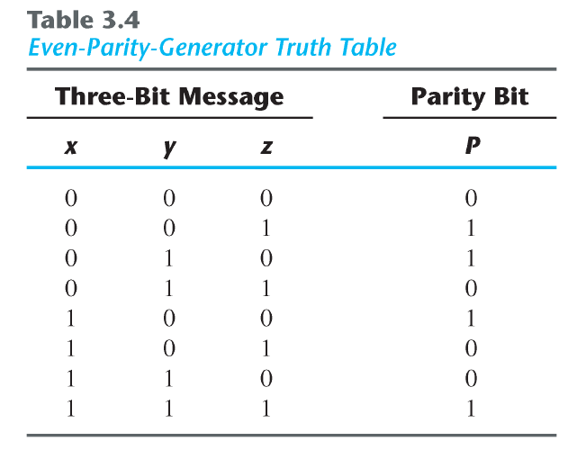
Even and Odd Parity

Slide 22
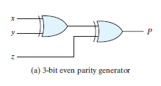
Parity Generator

